Slide 1

Dolling App
Go-to-Market / Sustainability Proposal
Notes:
This sample serves as a guideline on what should be covered on Go-to-Market / Sustainability Proposal

Slide 2
B21-CAP0114
Bintang Fathur Rahman (A0060605)
Muhammad Hisyam Zayd (A0060600)
Yohana Polin Simatupang (C1141458)
Gustavo Thiodorus (C0060598) Rian Nugroho (M0060602) Tiara Yania Ifani Lakita (M2082041)

Slide 3
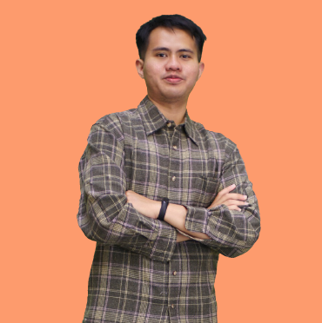
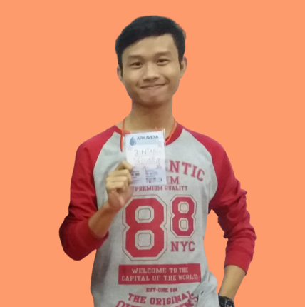
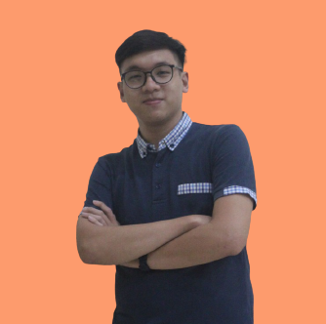
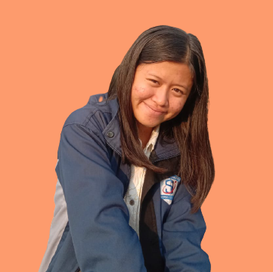
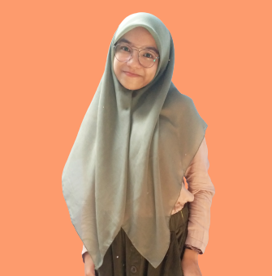

SaKe Team
Hisyam
Bintang
Gustavo
Yohana
Tiara
Rian

Slide 4
Backgrounder Facts
80 %
of our potential customers are thriving for new solutions

Slide 5
Backgrounder
What are you trying to achieve/solve?
According to some survey results from the research in the article "Tugas Akhir Mata Kuliah Perancangan Pengalaman Pengguna - Aplikasi E-Food Khusus Pedagang Keliling Dolling (Dodol Keliling)" as many as 82.6% of respondents complained that it was difficult to predict the arrival of Pedagang Keliling and 73.9% of respondents considered buying from mobile vendors is more practical than buying from a regular vendor.
Is there anything been done before?
Based on article "Tugas Akhir Mata Kuliah Perancangan Pengalaman Pengguna - Aplikasi E-Food Khusus Pedagang Keliling Dolling (Dodol Keliling)". Their try to solve the problem but don't implement their idea in real product. New Dolling from our team add new idea and implement in this project. We added recommendation feature and tracking for the order. We, also add new feature to search for information about products with image similarity. In case, the product (Food) have different name (Like onde-onde and klepon)

Slide 6
Intro of your capstone project
Why your capstone project is built in the first place?
Dolling provides a platform for pedagang keliling to get customers by taking advantage of online ordering and tracking location features. the ease of using the services of dolling will attract customers and will certainly improve the Indonesian economic sector.
What are the advantages of your capstone project?
Dolling provides free shipping services to customers for every product purchased. Free shipping does not harm pedagang keliling, we provide options and limitations for pedagang keliling to accept or reject orders. Pedagang keliling are given the convenience to reach their larger target market and able to get information of interested customer in the products being sold by utilizing recommendations.

Slide 7
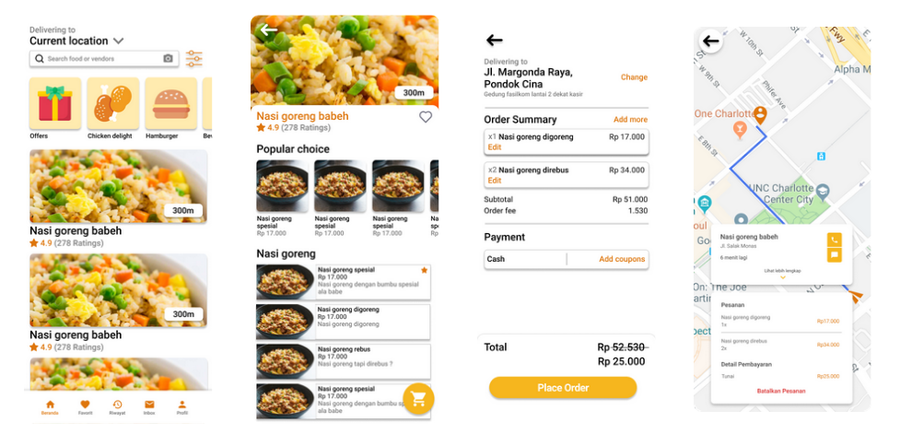
Buying Food App Flow
Screenshots of your app

Slide 8
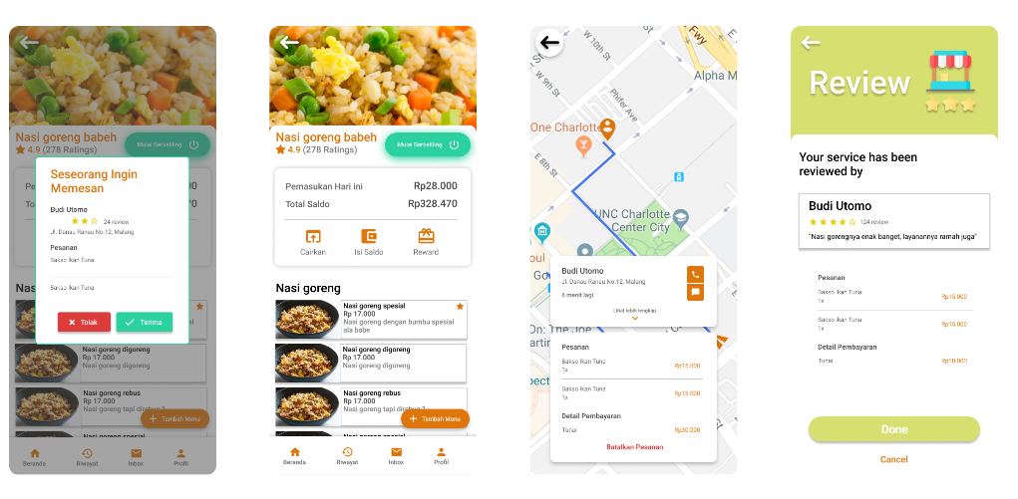
Seller App Flow
Screenshots of your app

Slide 9

Target Market or Personas
Age range
13 > age < 45
Profession
Student
WifeHouse
Office Staff
Pedagang Keliling
Roles
Buyers
Sellers
Specific Attributes or likings, hobbies
Have a mobile phone and internet connection
Love to use the food and beverage delivery service

Slide 10
Why your target market needs your solution?
Purpose-driven
Simplify the selling process
Increase profits
Data-driven
Data from google trend food and beverage service will increase in 2021 and Ekhel Chandra from tokopedia said "Tokopedia mengalami peningkatan penjualan makanan 3 kali di akhir tahun 2020" so we can conclude that our services engaged in food and beverage services will continue to increase.
Government reasoning
In 2023, the government target as many as 6.1 million UKM/IKM onboarding with digitalization concept. Dolling's services provide freedom for Pedagang Keliling to sell and develop business and get their market.so, Dolling has an impact on that target.
Stakeholders related and benefitted from your solutions
Increase sales targets.
Simplify the buying and selling process.

Slide 11
Comparison to similar services/apps
70 % better
(Based on features, compared to Gofood, GrabFood, and Shopee Food)
Notes:
may

Slide 12
Dolling Roadmap
Commercial Value
Mobile app for supporting Pedagang Keliling Indonesia
Economy Resilience for Pedagang Keliling
Demands and Supplies
Increased demand from Food and Beverage services, especially for street culinary (Pedagang Keliling), and the absence of services that facilitate the online transaction process for Pedagang Keliling. Dolling supply one solution for Pedagang Keliling to market their product.
Business Opportunities
Ads from partnerships on Dolling app
Percentage of accommodation of products sold by Pedagang Keliling.
Technology Advantages
Facilitate business processes between Pedagang Keliling and Customers.
Tracking of Pedagang Keliling location

Slide 13
Tracking Bigger
Food and beverage service users have increased in 2021. This is also driven by an increasingly instant lifestyle, and pandemic situation, people choose to use delivery service to get food. we can growth 89%.
Benefits for long-term
Increased target market for mobile traders
Increase in the number of mobile traders and enthusiasts.
Problem In Future
Decrease in street food enthusiasts
Changes in government regulations Regarding business licenses
New Competitor and Cash Flow
Indirect Benerifs
Increasing Indonesian SMEs

Slide 14
Project Milestones for 2021
(to end of year)
Business And Project Plan 1. Project Chapter 2. Project Plan 3. Get Pathnership
Project Implementation 1. Layout 2.Create Model 3.Database integration 4. Backend API
Project Implementation 1. Database Normalization 2. UO/UC Testing 3. Security Testing
July
July
November
August
October
December
Project Design 1. Database Design 2. UI/UX Design 3. Infrastructure Design
Project Implementation 1. Firebase Integration 2. Training Model 3. Backend ML API
Project Closing 1. Project Closure 2. Promotion and Training for Pedagang Keliling

Slide 15
Budgeting - 1 - USD 5k / IDR 70m
Category | Proportions (max) | Budget (max) in USD
Team Salary ( 6 Person) | 46,3% | $2273.72 / Rp 32.400.000
Research / Operational GCP Service Compute Engine Cloud run AI platform Cloud Load Balancer Cloud Pub/Sub Bigquery ML Cloud Storage Firestore Hosting App in Play store and App Store License Project Management Tools | 53,7% | $3.700 / Rp 37.600.000
Notes:
See details on: https://kedaireka.id/matchingfund https://kedaireka.id/panduan/panduan_matching_fund.pdf

Slide 16
Budgeting - 1 - USD 5k / IDR 70m
Category | Proportions (max) | Budget (max) in USD
Business Cost Market Analysis Competitor Analysis Ads Payment (Instagram, Youtube) Additional salary for external experts 4.1. UI/UX Design 4.2. Business Analyst
Total |  | $ 5.000 / Rp 70.000.000
Notes:
See details on: https://kedaireka.id/matchingfund https://kedaireka.id/panduan/panduan_matching_fund.pdf

Slide 17
Based on the 5k USD Budgeting, expectations are
5K Funding
Expected Runway: 6 months
Expected Headcount: 8 people
Assets: - copyright (Our App)
- data
- Customer Relationship
Notes:
Sample, please modify

Slide 18
Sustainability
Sources of Income
Efficiency Priority
Percentage of profit sharing with Pedagang Keliling
: $ (0,025 * Pedagang Keliling Profit)
Rounds of Funding (pembiayaan): $ 15K
Partner ads in slide ads : $ 36/Slide/Day
Running with bare-minimum operations
Reducing overhead and unnecessary costs
Choose appropriate services and Technology
Collaborate with partnership
Notes:
Sample, please modify

